Slide 1
MSc Artificial Intelligence
Knowledge Engineering
15 November 2023
Notes:
This colour bar is to be used for Artificial Intelligence

Slide 2
How Automated Reasoning works
Natural deduction has many rules
How we apply them and in what order is not obvious and relies on “human intuition”.
Computers don’t have human intuition…..

Slide 3
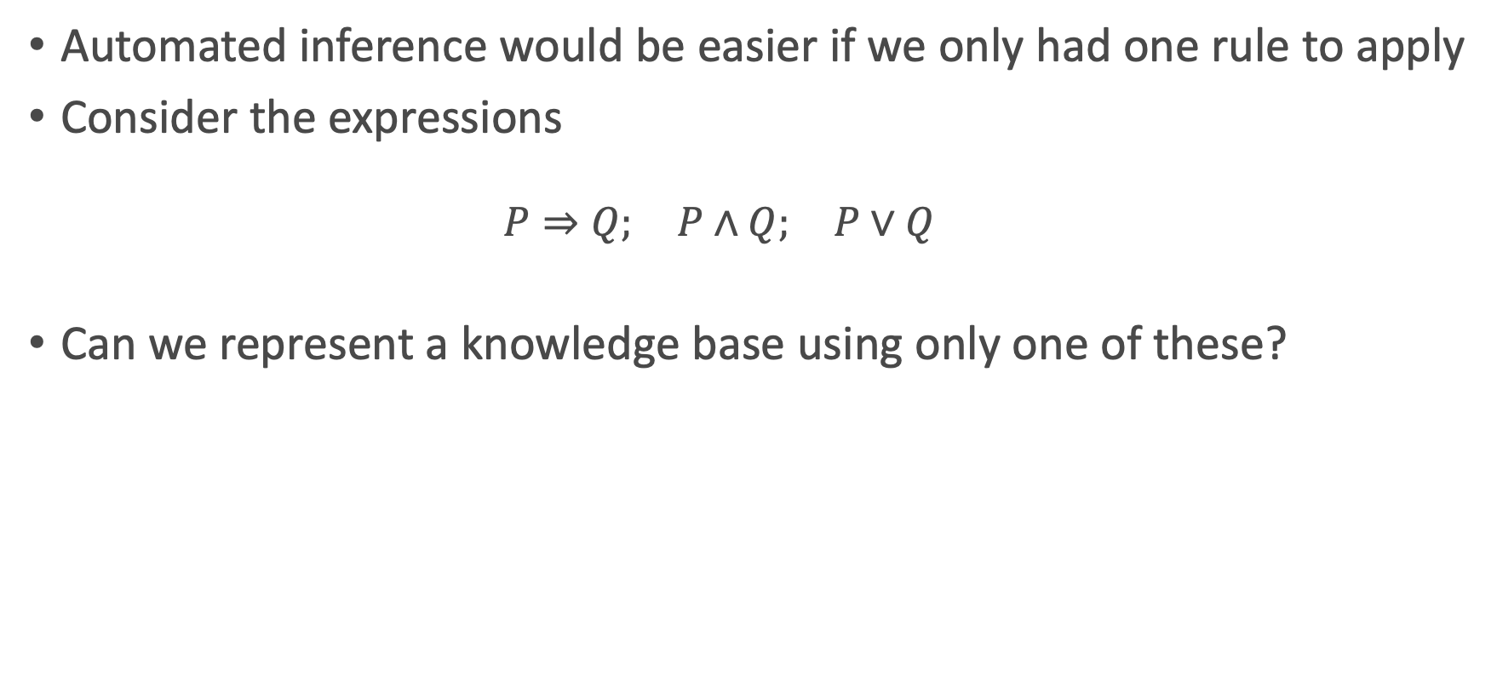
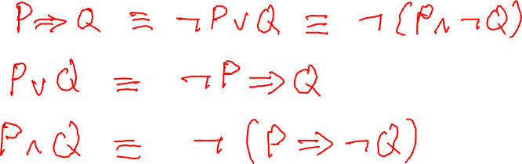
Logical Equivalencies
Automated inference would be easier if we only had one rule to apply
Consider the expressions
$$P⇒Q; P∧Q; P∨Q$$
Can we represent a knowledge base using only one of these?
Notes:
P=>Q is !PvQ == !(P^!Q)
Therefore PvQ == !P=>Q and P^Q == !(P=>!Q)

Slide 4
Rule Based Systems
If we can represent a Knowledge base purely in terms of material implication and negation, we only need one inference rule: modus ponens
Will allow us to prove logical statements by either:
Systematically deriving new facts until we find the one we want
Systematically exploring the known facts to establish compatibility.

Slide 5
An Example
1. A ⇒ V 2. B ⇒ U 3. B ⇒ V 4. C ⇒ U 5. C ⇒ W 6. D ⇒ X 7. D ⇒ Z 8. E ⇒ W 9. E ⇒ X 10. F ⇒ Y 11. F ⇒ Z 12. U ⇒ O 13. V ⇒ O 14. W ⇒ O
15. W ⇒ I 16. X ⇒ I 17. Y ⇒ I 18. Y ⇒ O 19. Z ⇒ I
Knowledge base of medical treatments.
Includes facts about diseases and the medicines that can be used to treat them:
There are six diseases {A, B, C, D, E, F }.
There are five medicines {U, V, W, X, Y, Z}
The medicines are available in either oral or injectable form {O, I}.
KB tells us which medicines treat a disease, and what form each medicine is available in
We have the following rules:

Slide 6
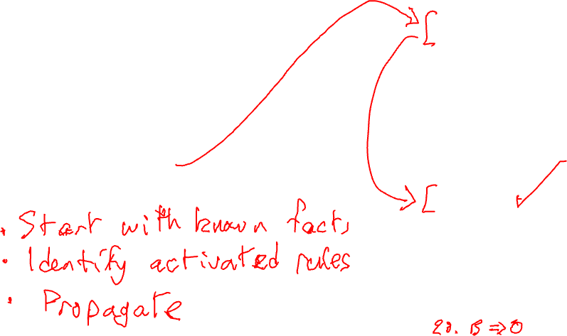
Forward Chaining
1. A ⇒ V 2. B ⇒ U 3. B ⇒ V 4. C ⇒ U 5. C ⇒ W 6. D ⇒ X 7. D ⇒ Z 8. E ⇒ W 9. E ⇒ X 10. F ⇒ Y 11. F ⇒ Z 12. U ⇒ O 13. V ⇒ O 14. W ⇒ O
15. W ⇒ I 16. X ⇒ I 17. Y ⇒ I 18. Y ⇒ O 19. Z ⇒ I
In forward chaining, we start with a fact and a goal, and we explore the implications in a forward direction to find out whether our goal is satisfied.
Given disease B (fact), is there an oral medication available (goal)?

Slide 7
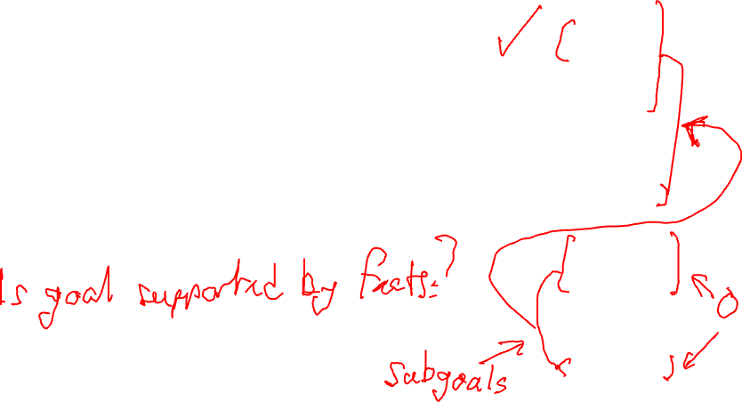
Backward Chaining
1. A ⇒ V 2. B ⇒ U 3. B ⇒ V 4. C ⇒ U 5. C ⇒ W 6. D ⇒ X 7. D ⇒ Z 8. E ⇒ W 9. E ⇒ X 10. F ⇒ Y 11. F ⇒ Z 12. U ⇒ O 13. V ⇒ O 14. W ⇒ O
15. W ⇒ I 16. X ⇒ I 17. Y ⇒ I 18. Y ⇒ O 19. Z ⇒ I
In backward chaining, we start with our goal, and work through the implications backwards to see if the goal is supported by the facts
Given that the patient wants oral medication O, is that suitable for their disease B?

Slide 8
Forward vs Backward Chaining
1. A ⇒ V 2. B ⇒ U 3. B ⇒ V 4. C ⇒ U 5. C ⇒ W 6. D ⇒ X 7. D ⇒ Z 8. E ⇒ W 9. E ⇒ X 10. F ⇒ Y 11. F ⇒ Z 12. U ⇒ O 13. V ⇒ O 14. W ⇒ O
15. W ⇒ I 16. X ⇒ I 17. Y ⇒ I 18. Y ⇒ O 19. Z ⇒ I
Forward chaining: given the facts, what goals can we solve?
Backward chaining: is the goal we want to solve supported by the evidence?

Slide 9
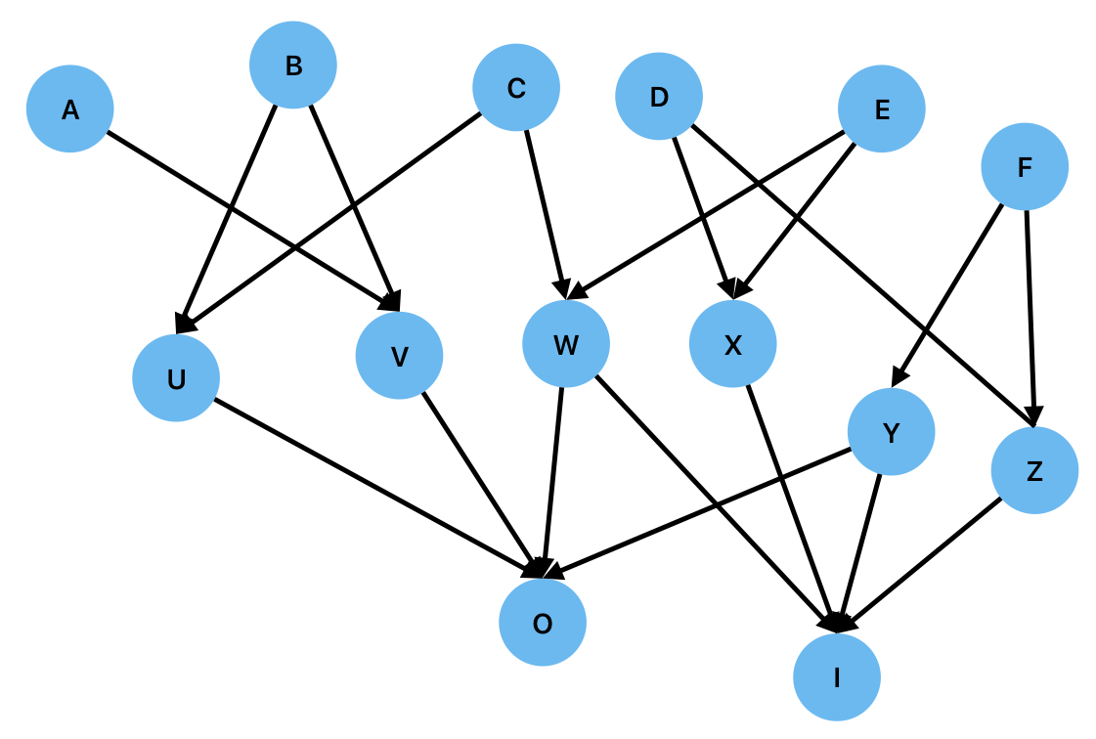
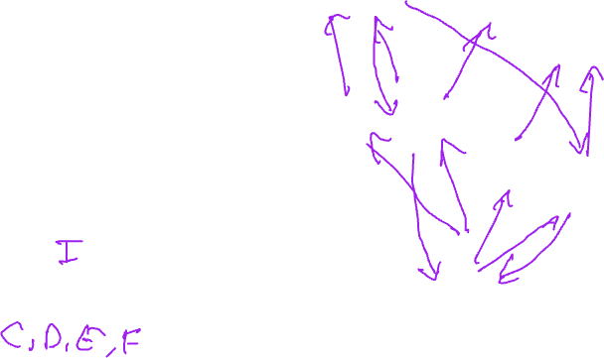
Search and Proof
1. A ⇒ V 2. B ⇒ U 3. B ⇒ V 4. C ⇒ U 5. C ⇒ W 6. D ⇒ X 7. D ⇒ Z 8. E ⇒ W 9. E ⇒ X 10. F ⇒ Y 11. F ⇒ Z 12. U ⇒ O 13. V ⇒ O 14. W ⇒ O
15. W ⇒ I 16. X ⇒ I 17. Y ⇒ I 18. Y ⇒ O 19. Z ⇒ I
What forms of drug can be used to treat disease D?
What diseases can be treated with an injection?

Slide 10
Search and Proof
Inference in rule based systems is equivalent to search on a directed graph
A proof corresponds to finding a path in the graph between the premises and the goal.
In forward chaining, we start with the premises
Patients has disease B. Can we treat it with Oral medication?
In backward chaining, we start with the goal
Oral medication. Can it treat disease B?
Both cases require us to traverse the graph. How to do this systematically?

Slide 11
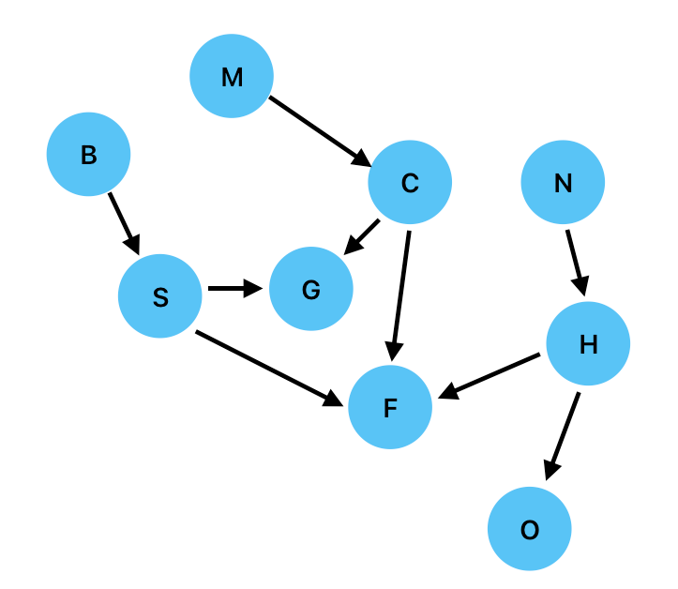
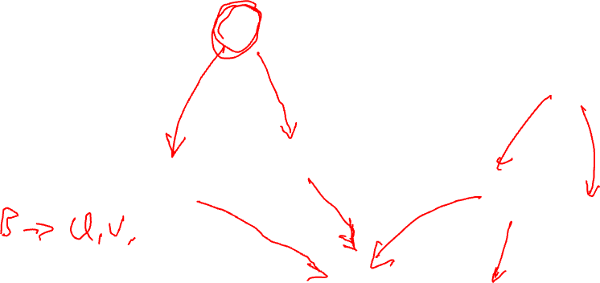
Breadth-First Search (Forward Chaining)

Slide 12
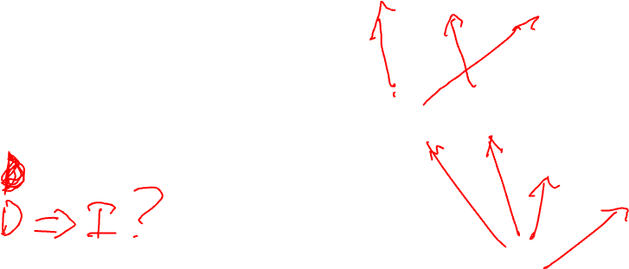
Breadth-First Search (Backward Chaining)

Slide 13
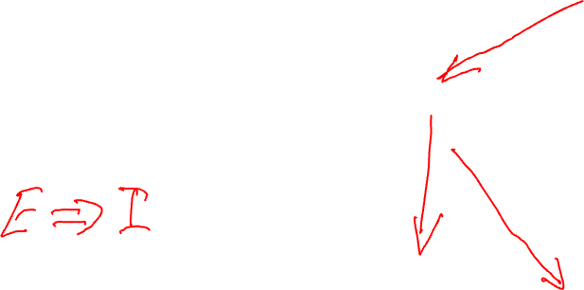
Depth-First Search (Forward Chaining)

Slide 14
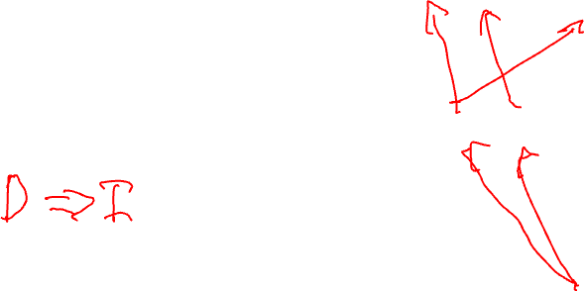
Depth-First Search (Backward Chaining)

Slide 15
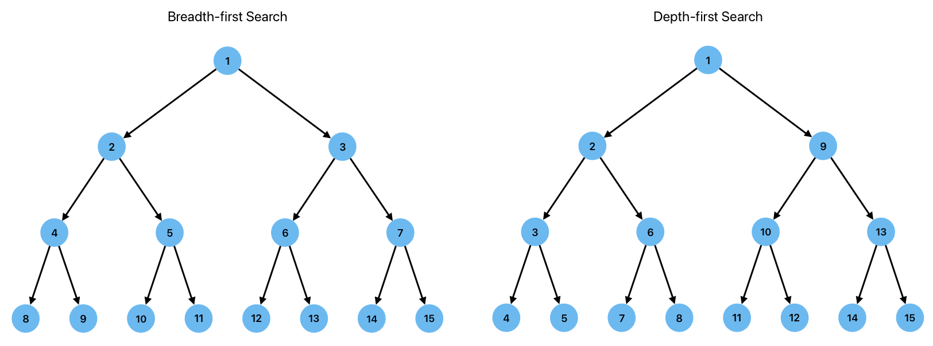
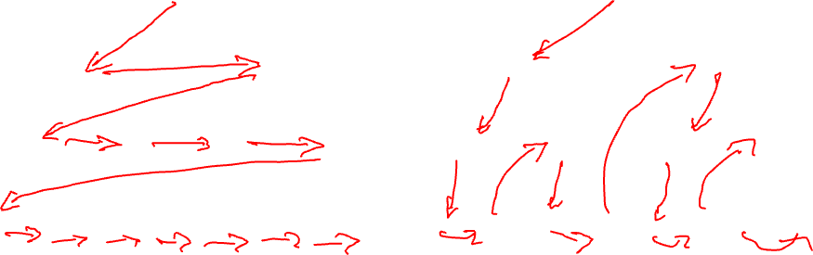
Breadth vs Depth-First Search

Slide 16
Exercises 6: Automating Natural Deduction

Slide 17
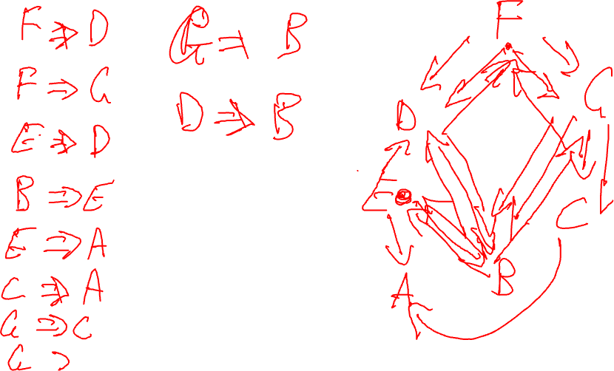

Slide 18
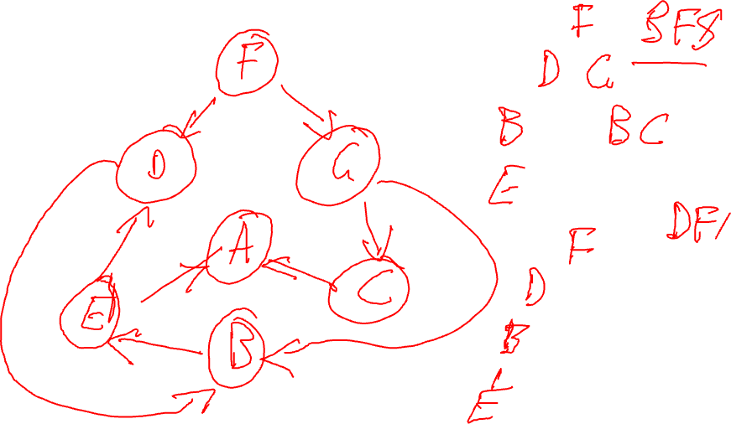

Slide 19
Day 2 Wrap-up
Logic programming with Kanren
Forward and Backward Chaining
Proof and Search
Next Week:
First Order Logic

